Slide 1

WORLD LABS
MUJOCO
CESAR A. PASCAL

Slide 2
World Labs, more specifically Marble, is a tool used to generate three-dimensional environments from images, videos, and planes. Nonetheless, it is primarily useful for visualization purposes and cannot be used for simulations since it does not incorporate physics. However, once the 3D environment is created, the generated meshes are downloadable and can be used in other software, such as MuJoCo.

Slide 3
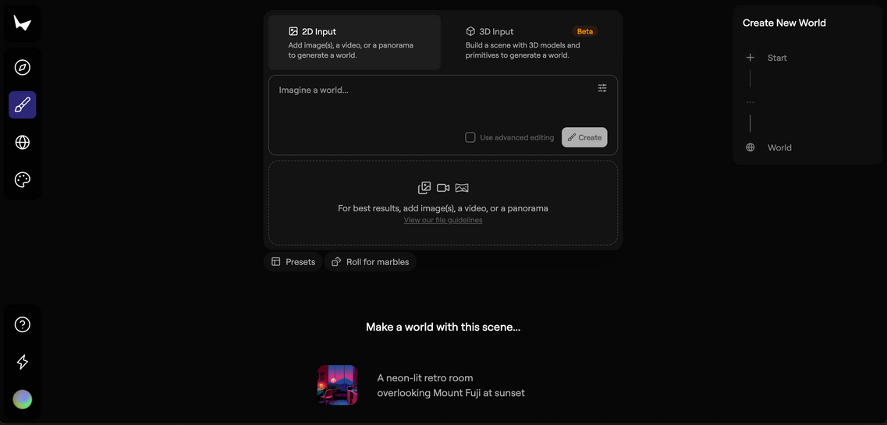
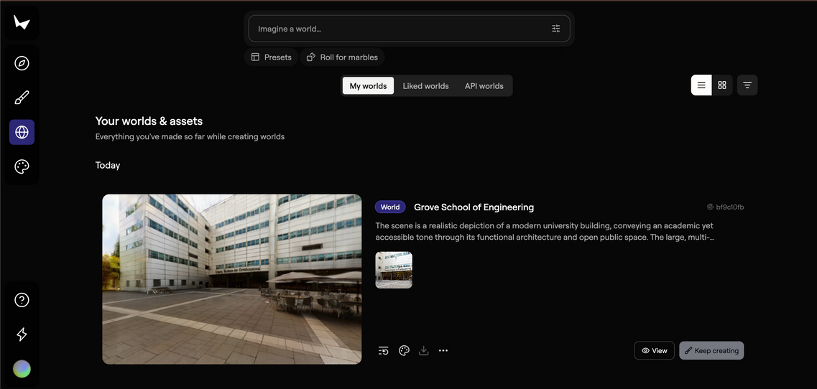
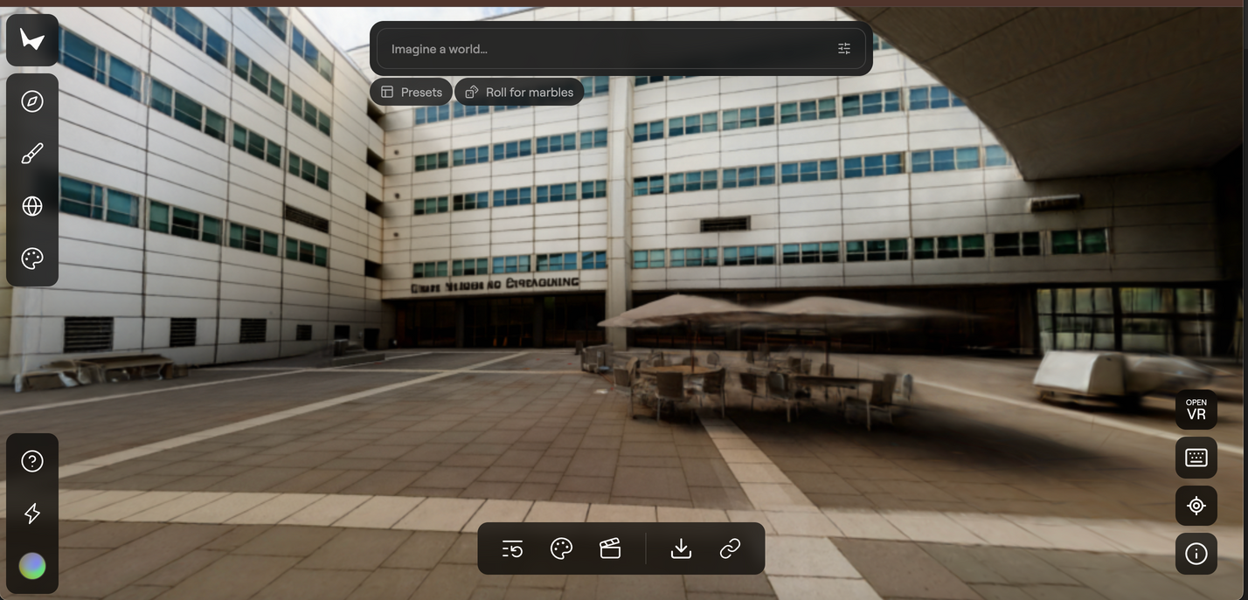
Here’s an example of its use.

Slide 4

For MuJoCo, I created a Python environment, as discussed in the previous meeting, in order to properly run and interface MuJoCo with Python.

Slide 5
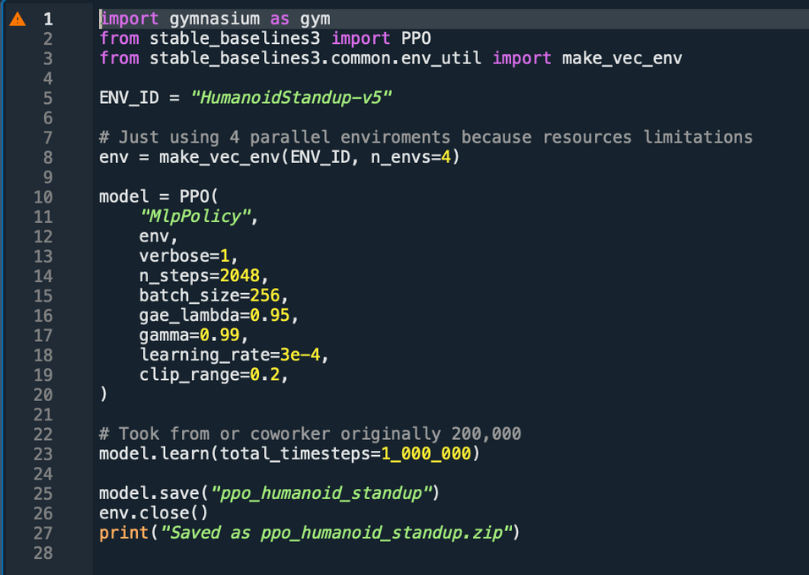
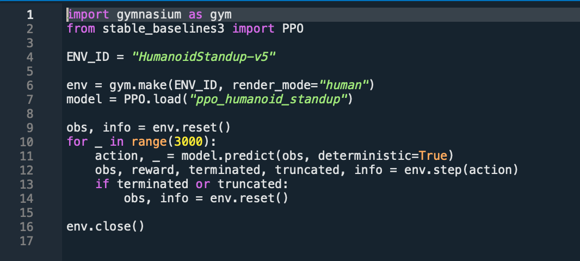
Once the environment was set up, I began working with a simple MuJoCo example of a humanoid robot using a model provided by MuJoCo to explore basic functionalities. This example also included a simple training process, as presented in the previous meeting.

Slide 6
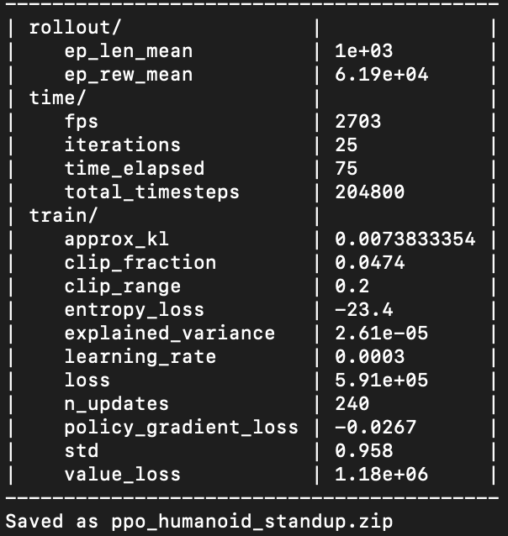
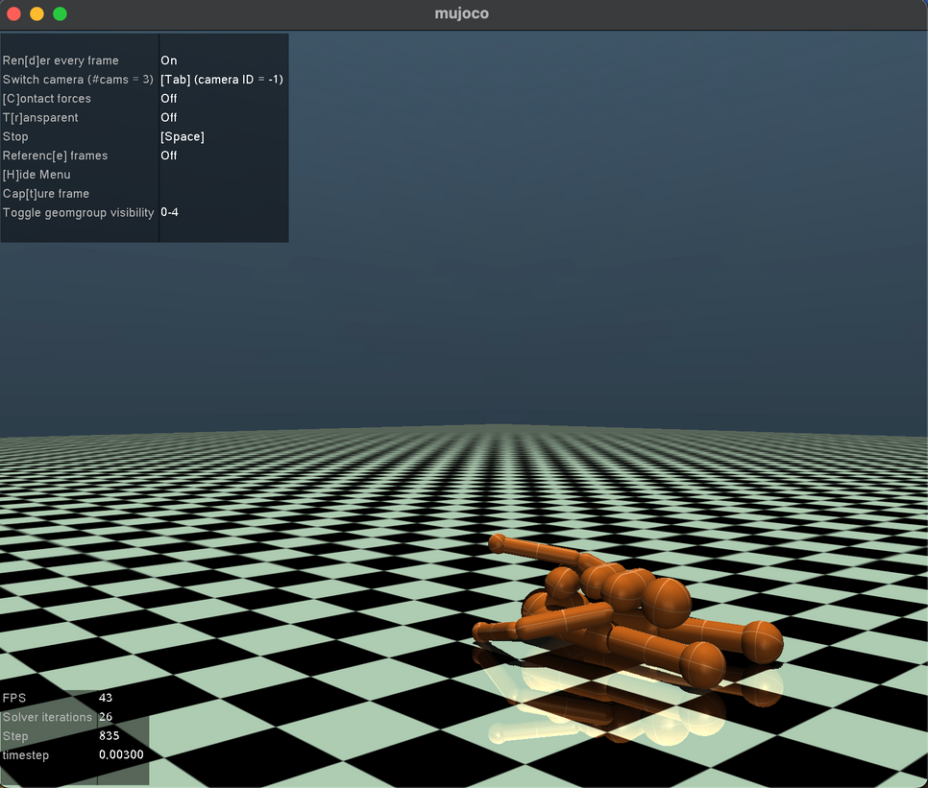
This training was not successful, as the loss value increased over the iterations, and the model was unable to maintain a standing posture.

Slide 7
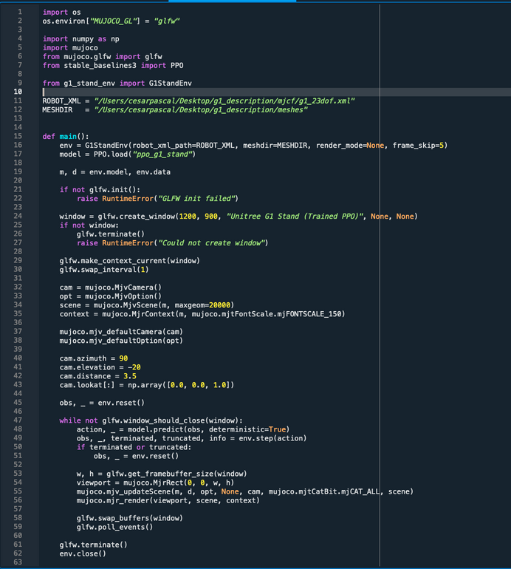
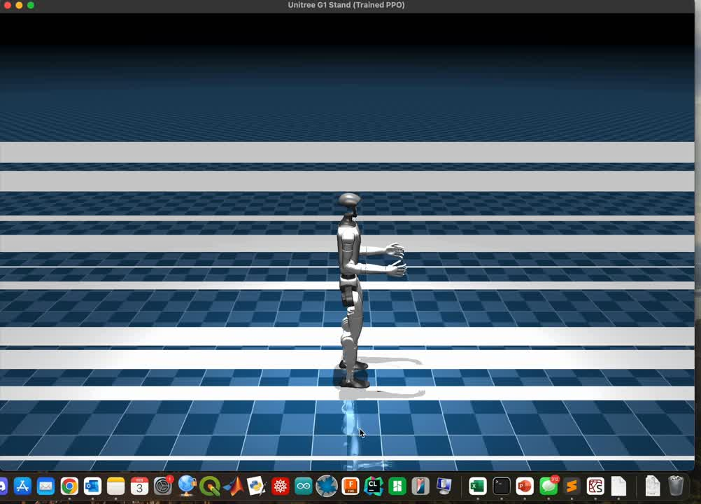
Furthermore, to implement an approach closer to the project goals, I used the G1 robot model, which is similar to the R1. For convenience, I selected the 23-DOF version instead of the 26-DOF version to facilitate training optimization and improve standing stability. Some rendering issues occurred during implementation, but they were successfully resolved.

Slide 8
Next Steps:
• Improve the rendering to allow clearer visualization of the simulation.
• Further refine the training process to reduce the loss value and achieve stable standing, with the potential to enable walking.
• Once successful results are obtained with the 23-DOF model, transition to the 26-DOF model to obtain more realistic outcomes.

Slide 9
References:
[1] Unitree Robotics, Unitree MuJoCo Models (G1 Humanoid Robot). GitHub repository.
https://github.com/unitreerobotics/unitree_mujoco
[2] MuJoCo, MuJoCo Physics Engine Documentation. Developed by DeepMind.
https://mujoco.readthedocs.io
[3] Schulman, J., Wolski, F., Dhariwal, P., Radford, A., & Klimov, O., Proximal Policy Optimization Algorithms, 2017.
https://arxiv.org/abs/1707.06347
[4] Raffin, A., et al., Stable-Baselines3: Reliable Reinforcement Learning Implementations. GitHub repository.
https://github.com/DLR-RM/stable-baselines3
[5] Farama Foundation, Gymnasium: A Standard API for Reinforcement Learning Environments. GitHub repository.
https://github.com/Farama-Foundation/Gymnasium

